Slide 1
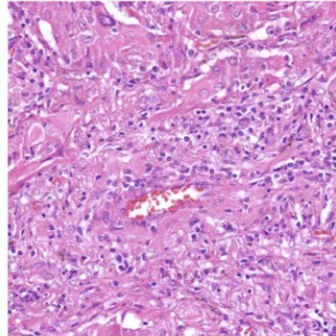
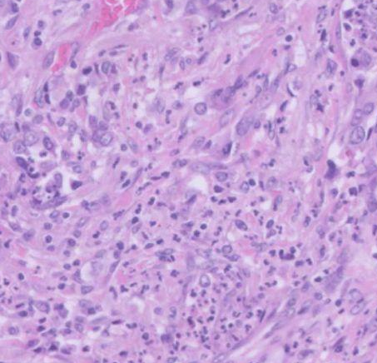
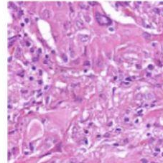
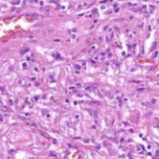
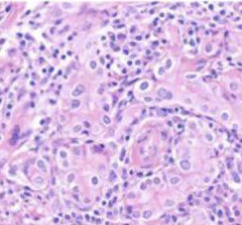
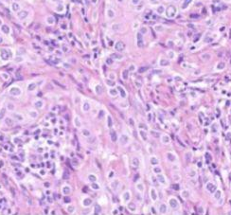
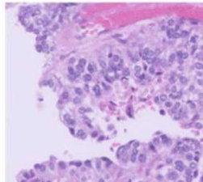
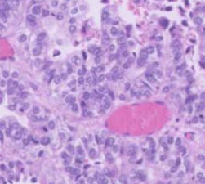
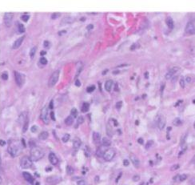
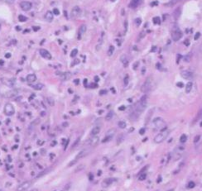
Two tumours, one origin?
AI triage for clonality of multiple tumours
Matthias Hagenauer
m.s.hagenauer@amsterdamumc.nl
?
FROM H&E PATCHES TO AN ANSWER
Clonal
Independent
Abstain

Slide 2
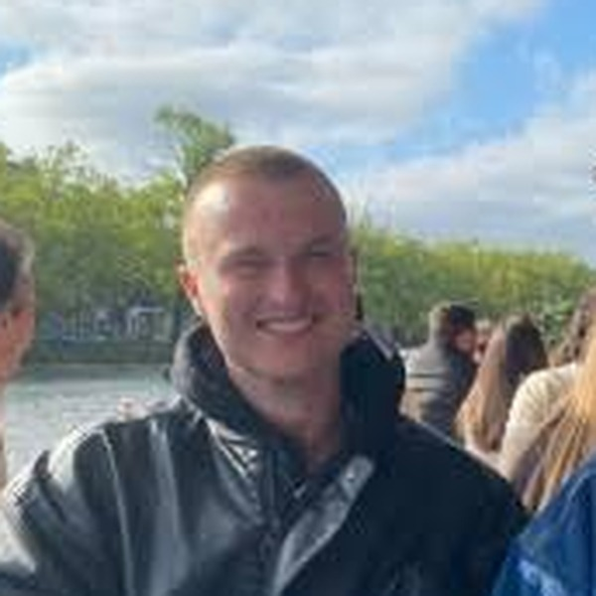
About me
From business informatics, via industry AI, to AI for pathology
2019 – 2023
B.Sc. Business Informatics, University of Mannheim
Thesis on algorithms for the NP-complete k-SAT problem
2021 – 2024
Applied AI in industry
Internships building a RAG chatbot (d-fine), document AI (Workist) and an LLM extraction pipeline (Enpal)
2024 – 2026
M.Sc. Artificial Intelligence, University of Amsterdam
TA for Algorithms & Data Structures, Text Retrieval and Game Theory
Matthias Hagenauer
Researcher, Multi-Modal AI Group
Pathology, Amsterdam UMC
2026 – now
Amsterdam UMC: thesis → researcher
Predicting tumour clonality from H&E slides with multiple instance learning. That's today's talk.

Slide 3
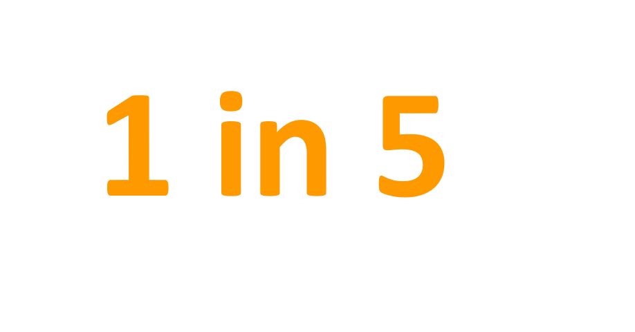

The Problem
lung cancer patients has or will develop multiple tumors over time
Notes:
isn't a rare edge case. It's a question pathologists and clinicians face regularly.

Slide 4

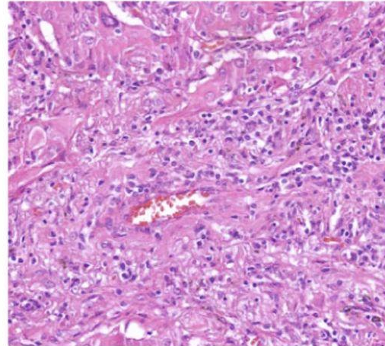
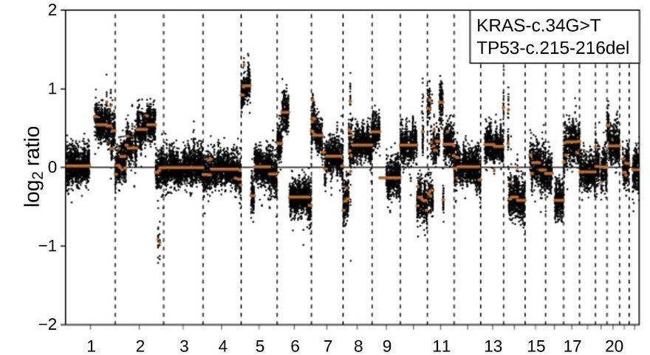
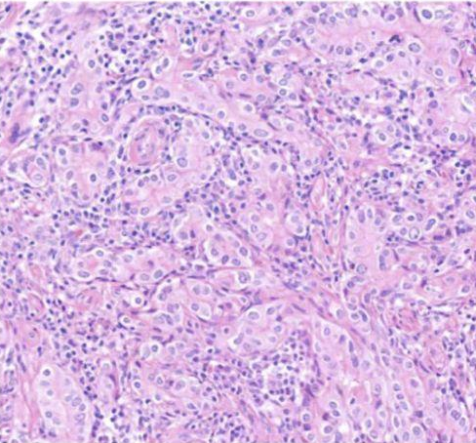
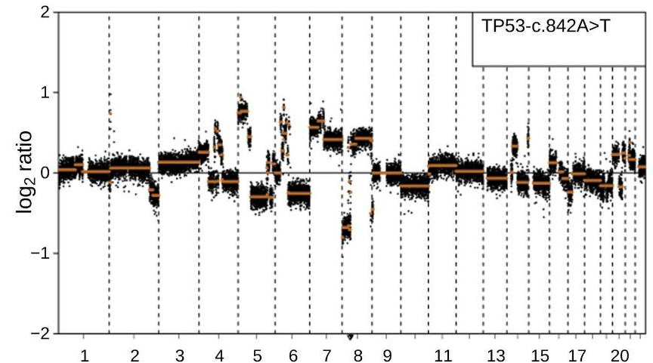
Problem
One in five lung cancer patients has or will develop multiple tumors over time
SCENARIO A
Multiple primary carcinomas Two independent tumours
Lung
Lung or elsewhere
Genetics
Different mutations & copy-number profiles
Stage
Each tumour staged on its own, often early
Treatment
Curative: surgery or radiotherapy
Prognosis
High survival potential

Slide 5
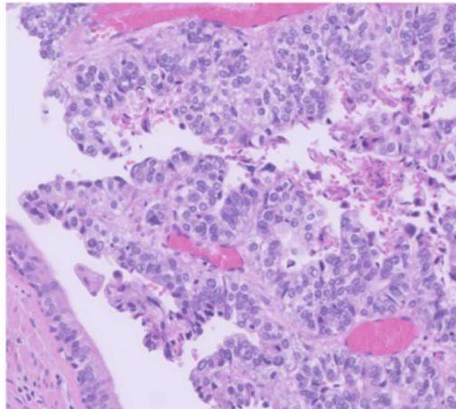
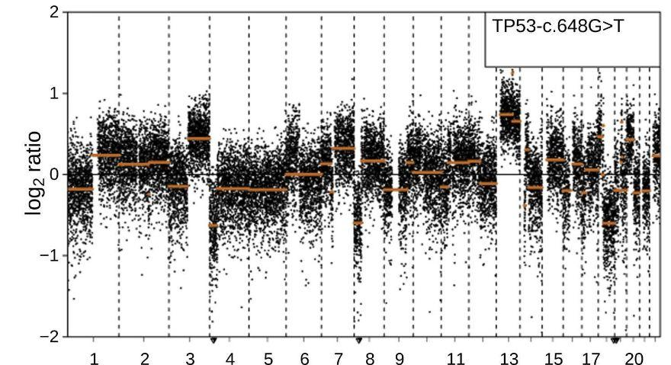
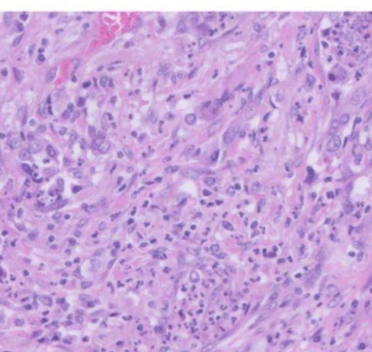
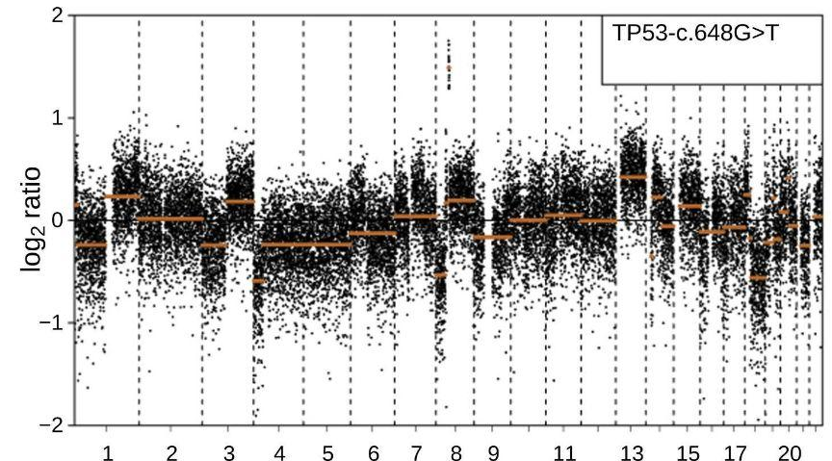
Problem
One in five lung cancer patients has or will develop multiple tumors over time
SCENARIO A
Multiple primary carcinomas Two independent tumours
SCENARIO B
Metastasis One tumour has spread (clonally related)
Lung
Lung
Lung or elsewhere
Lung or elsewhere
Genetics
Different mutations & copy-number profiles
Genetics
Shared mutations & copy-number profile
Stage
Each tumour staged on its own, often early
Stage
Advanced / metastatic (e.g. T3/T4/M1a)
Treatment
Curative: surgery or radiotherapy
Treatment
Palliative systemic therapy
Prognosis
High survival potential
Prognosis
Poor survival potential
Notes:
same picture, two tumours in one patient two completely different stories completely different treatments. Getting this right really matters.

Slide 6
Two kinds of DNA changes
Our DNA is packed into chromosomes. Each chromosome carries many genes.
Zoom into one chromosome
What a tumour can do to gene B
chromosome
CNA = copy-number alteration: the number of copies of a gene changes
Normal
A
B
C
each gene present once
Mutation
A
B
C
typo inside gene B
gene A
gene B
gene C
CNA: gain
gene B copied 3×
A
B
B
B
C
A gene is a stretch of DNA that holds the recipe for one protein.
CNA: loss
gene B missing
A
C
Which genes are mutated, gained or lost forms a fingerprint of the tumour
Notes:
Our DNA is packed into chromosomes. If we zoom into one chromosome, we find genes: stretches of DNA that each hold the recipe for one protein. A tumour can damage a gene in two ways. A mutation is a small change: one letter inside the gene is wrong, so the recipe has a typo. A copy-number alteration, or CNA, changes how many copies of the gene there are. With a gain, gene B is copied and is now there three times, so the cell makes too much of that protein. With a loss, gene B is simply gone. (Strictly, every cell has two copies of each chromosome, one from each parent, so 'normal' means two copies of each gene; I show one copy to keep it simple.) Sequencing measures both kinds of change, and which genes are mutated, gained or lost together form a fingerprint of the tumour.

Slide 7
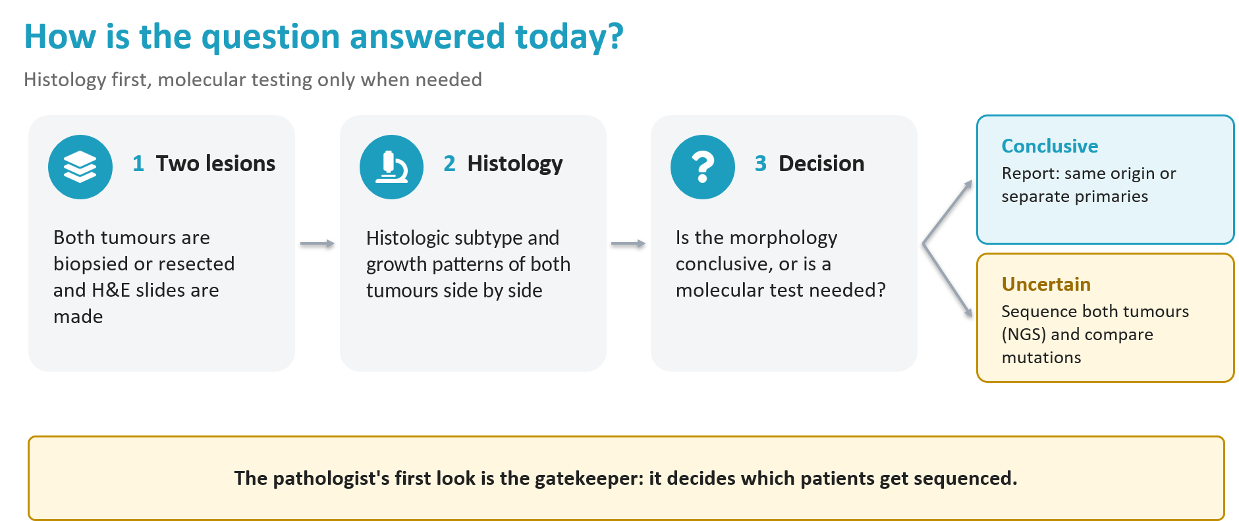

Slide 8
Challenges in Genomic Profiling for Multiple Lesions
Sequencing is expensive & time consuming
• In our setting ≈ €1,700 per tumour and >1 week turnaround
• Needs sufficient tumour material from both lesions
• Availability of comprehensive profiling varies strongly between countries
IASLC Pathology Committee recommendations, J Thorac Oncol 2024
Histology vs. sequencing disagree often
• 76 tumour pairs, prospective histologic call vs. MSK-IMPACT NGS
• Discordant in 22 % of pairs overall
• 30 % discordant when histology called 'metastasis'
Chang et al., Clin Cancer Res 2019
• Discordant in 24 % of pairs overall
Allgäuer et al., Journal of Thoracic Oncology 2026

Slide 9
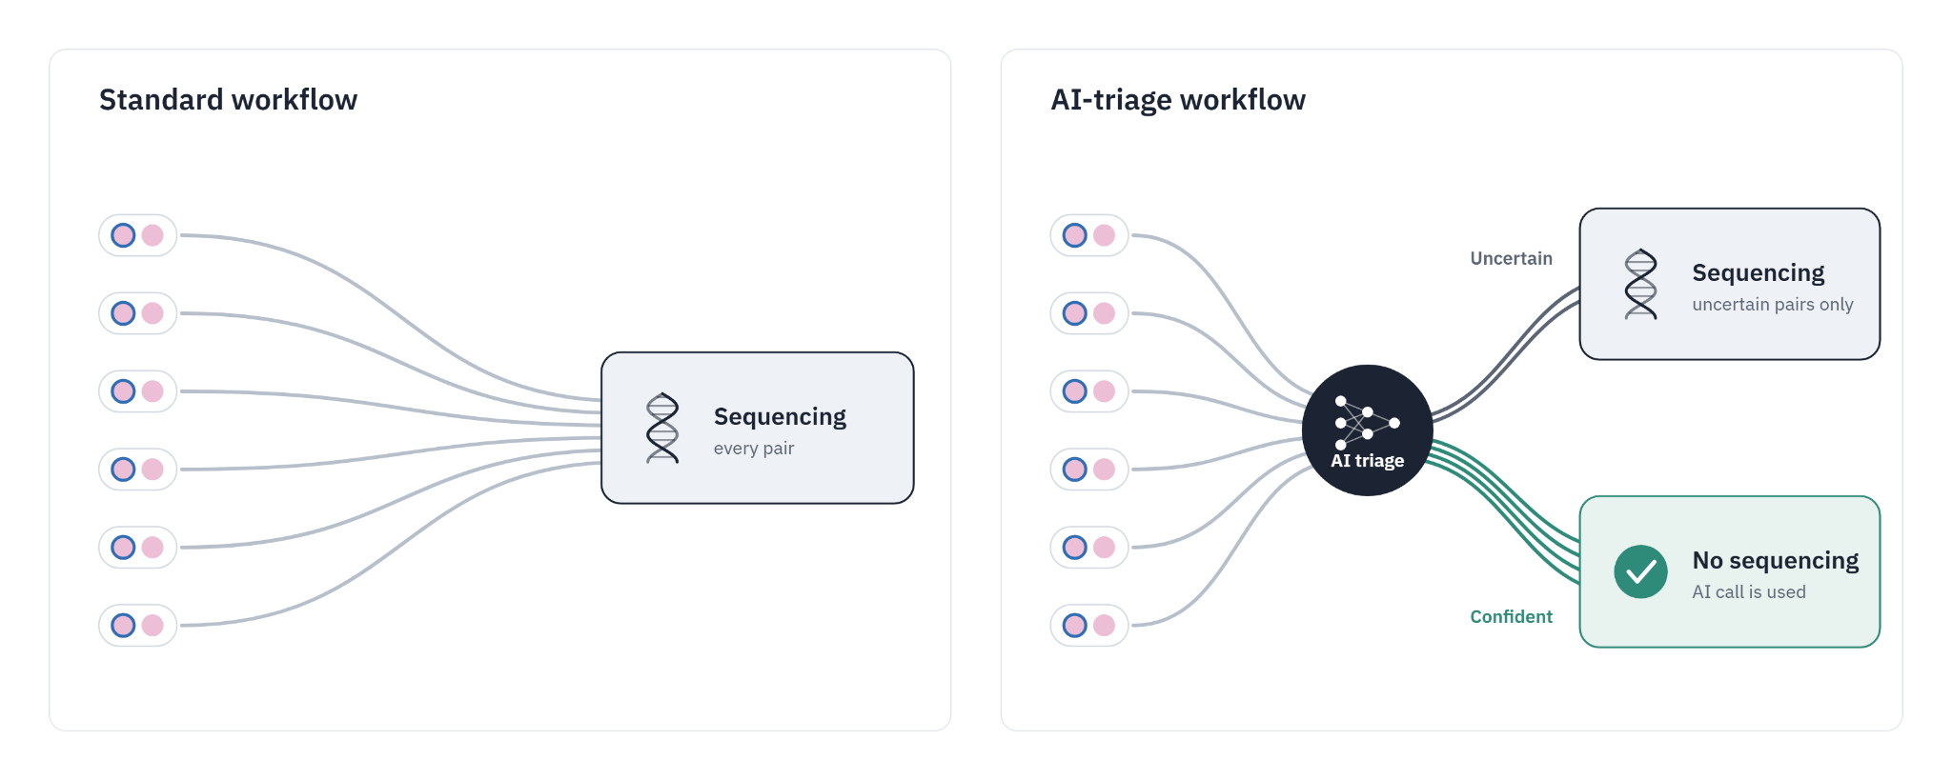
The goal: An AI-Triage Tool

Slide 10
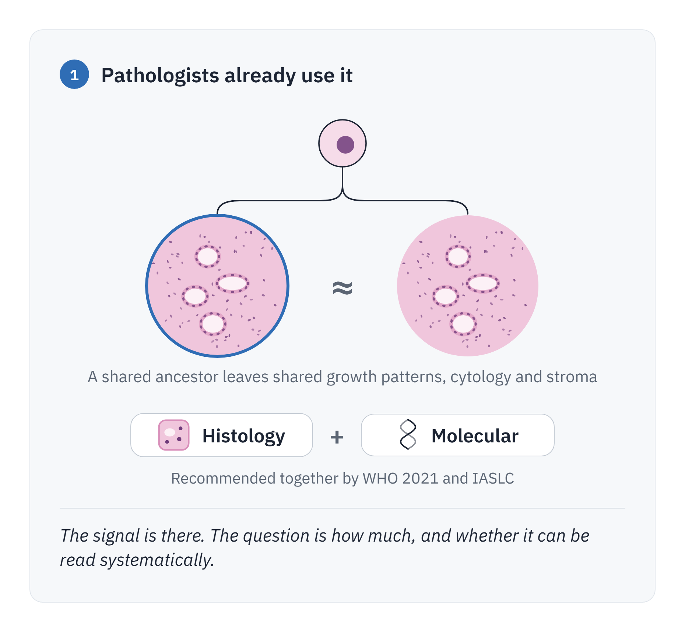
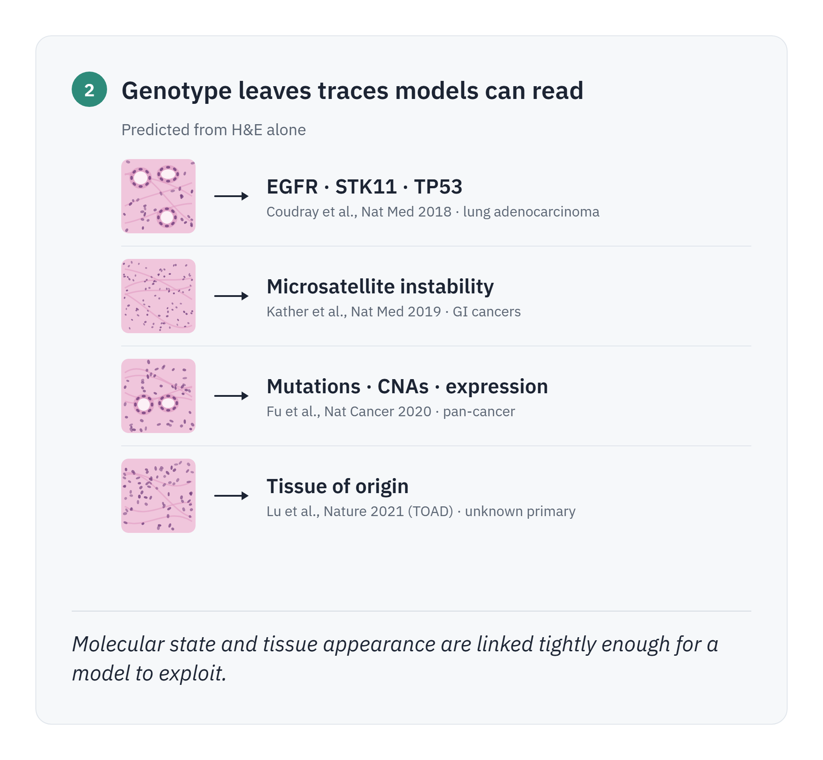
Is the clonal relationship of tumors visible on WSIs?
Two lines of evidence say the idea is reasonable

Slide 11
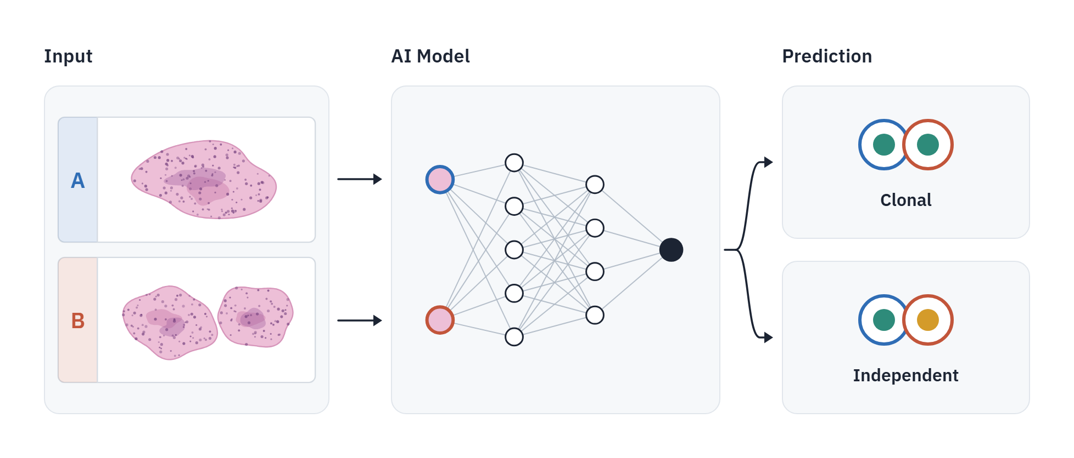
Deep Learning-Based Clonality Assessment from Paired WSIs

Slide 12
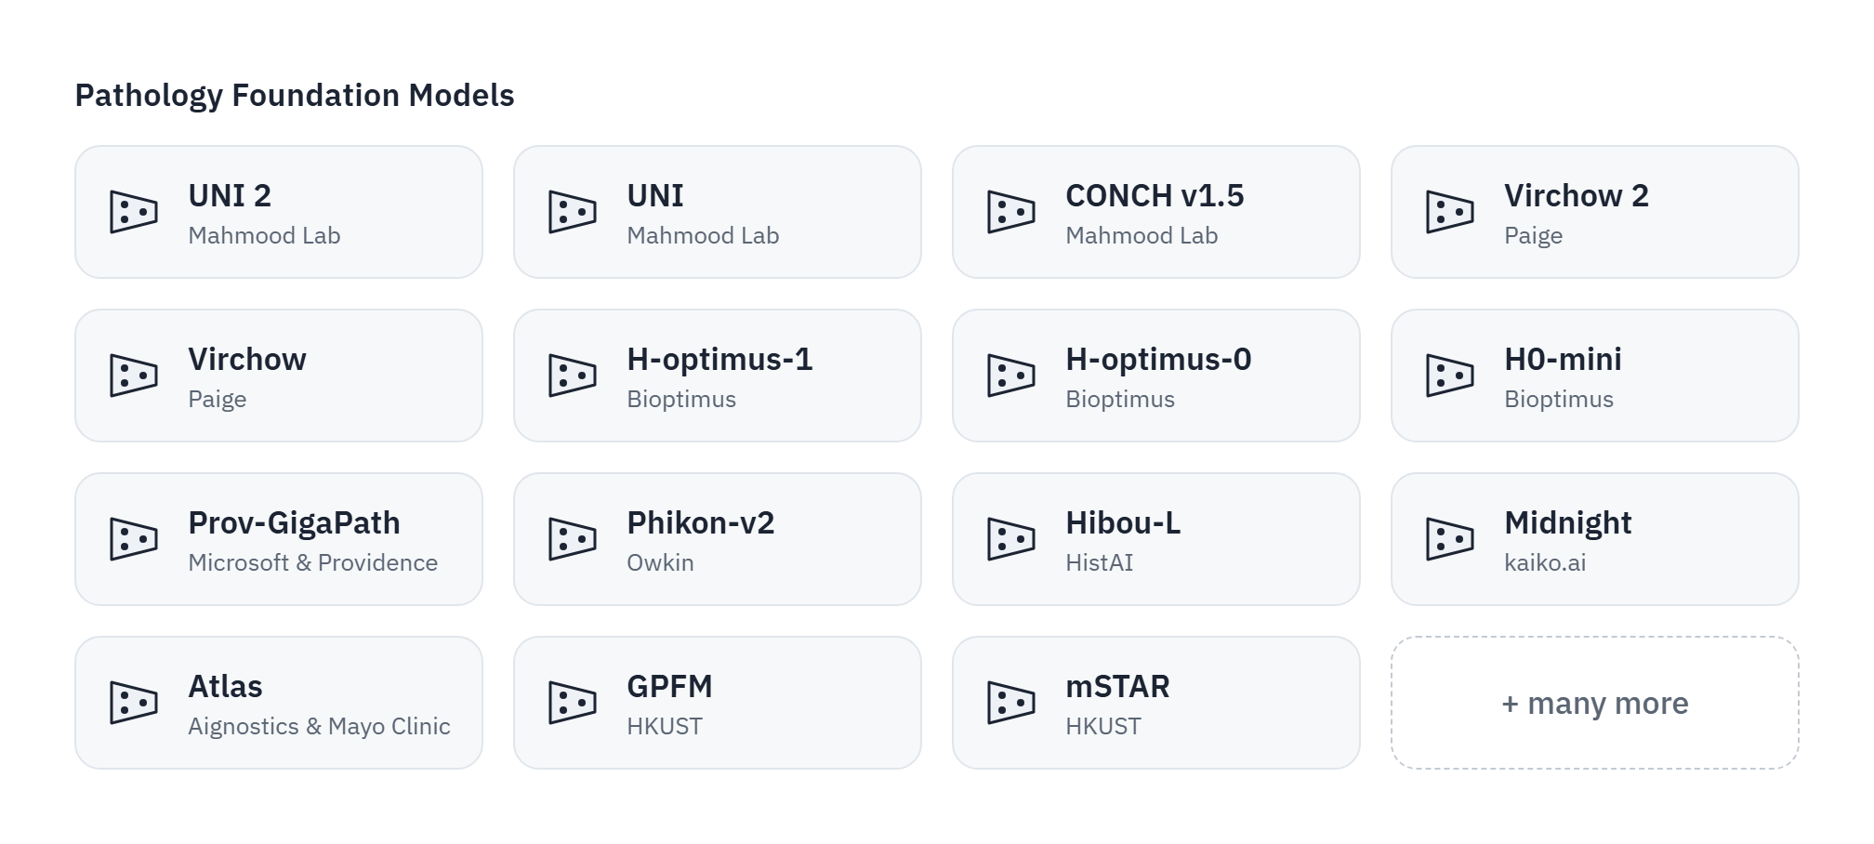
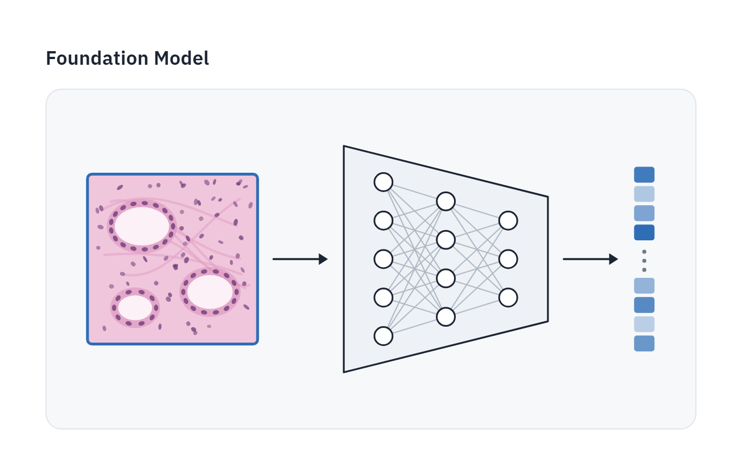
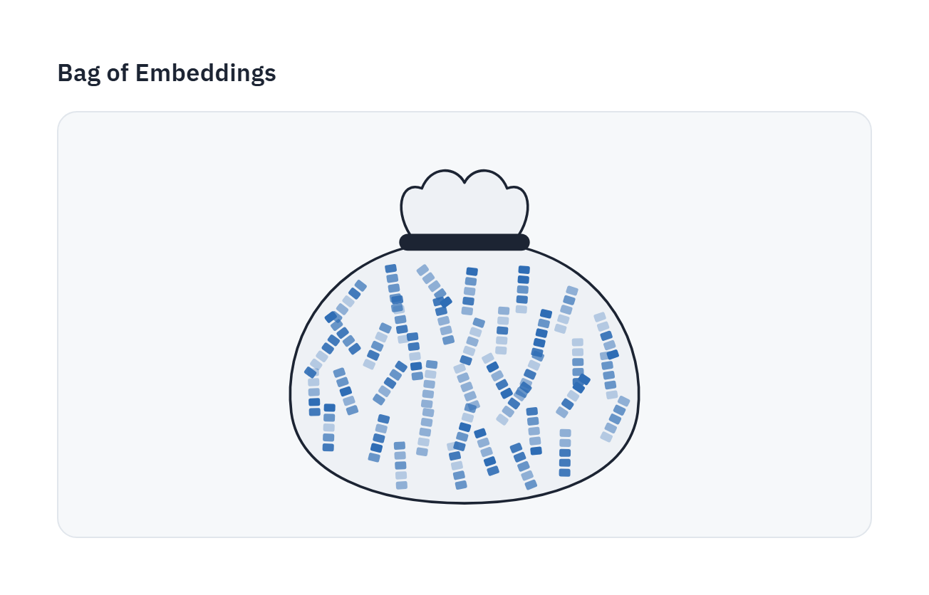
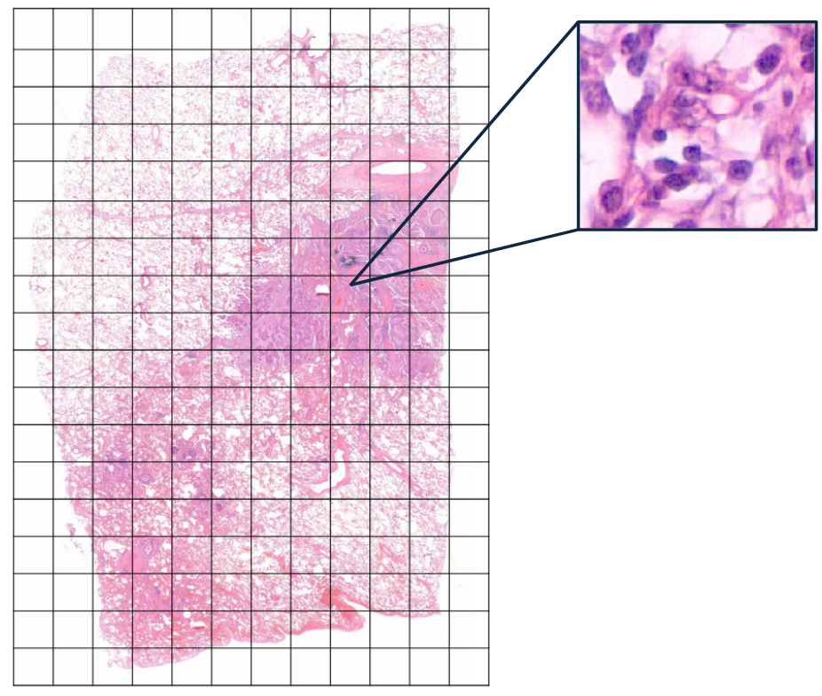
Step by Step Overview - Foundation Model

Slide 13
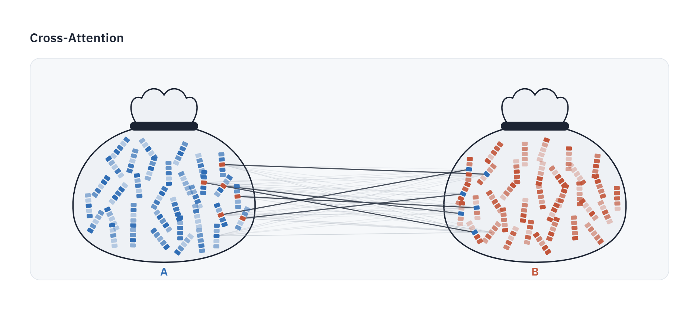
Step by Step Overview - Cross-Attention

Slide 14
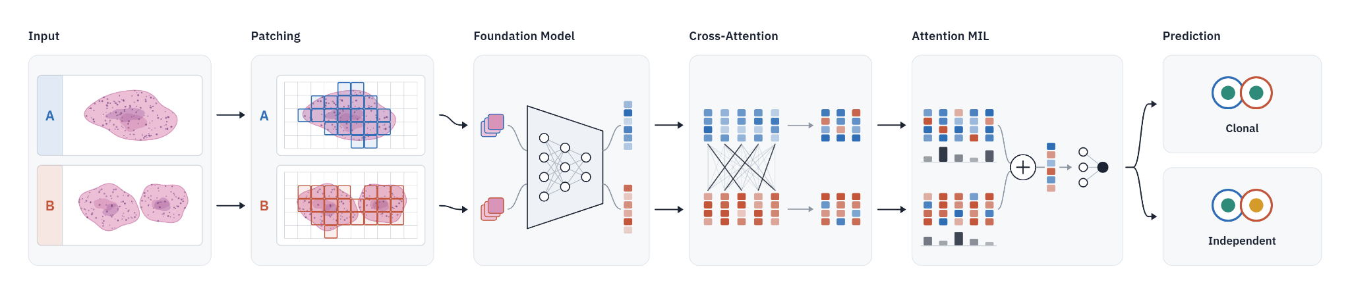
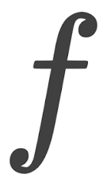
Step by Step Overview - Attention MIL
Each tile gets an attention weight (“Importance”).

Slide 15

Deep Learning-Based Clonality Assessment from Paired WSIs

Slide 16
The data: 215 lesion pairs with a molecular answer
four cohorts, adenocarcinoma and squamous cell carcinoma, all with sequencing-based clonality labels
Cohort | Slides | Pairs | Clonal | Note
Heidelberg | 240 | 106 | 49 % | biopsies and resections
Amsterdam UMC - A | 99 | 62 | 55 % | biopsies and resections
Amsterdam UMC - B | 58 | 31 | 68 % | biopsies and resections
Amsterdam UMC - Lung Scope | 26 | 13 | 100 % | curated resections, clonal only
Total | 423 | 215 | 56 % | 120 clonal · 95 non-clonal
Phase 1 (thesis, spring 2026)
96 pairs from 3 sources; 59 clonal, 37 non-clonal
Phase 2 (now)
215 pairs, 4 cohorts, patient identifiers on every slide, per-cohort evaluation & expecting more pairs to come.
Small for deep learning, but to our knowledge the largest paired H&E clonality set with molecular ground truth.

Slide 17
The data: 215 lesion pairs with a molecular answer
four cohorts, adenocarcinoma and squamous cell carcinoma, all with sequencing-based clonality labels
Cohort | Slides | Pairs | Clonal | Note
Heidelberg | 240 | 106 | 49 % | biopsies and resections
Amsterdam UMC - A | 99 | 62 | 55 % | biopsies and resections
Amsterdam UMC - B | 58 | 31 | 68 % | biopsies and resections
Amsterdam UMC - Lung Scope | 26 | 13 | 100 % | curated resections, clonal only
Total | 423 | 215 | 56 % | 120 clonal · 95 non-clonal
Phase 1 (thesis, spring 2026)
96 pairs from 3 sources; 59 clonal, 37 independent
Phase 1 (thesis, spring 2026)
96 pairs from 3 sources; 59 clonal, 37 non-clonal
Phase 2 (now)
215 pairs, 4 cohorts, patient identifiers on every slide, per-cohort evaluation & expecting more pairs to come.
Small for deep learning, but to our knowledge the largest paired H&E clonality set with molecular ground truth.

Slide 18
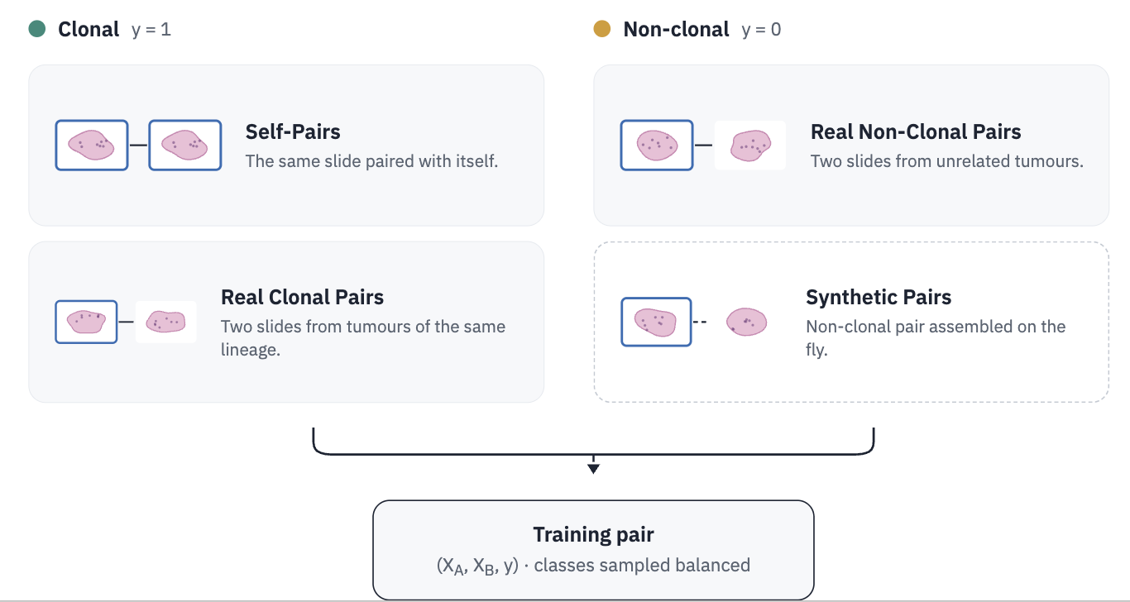
Data Strategy

Slide 19
Data Strategy

Slide 20
Data Strategy

Slide 21

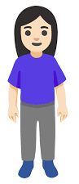
Data Strategy

Slide 22
Data Strategy

Slide 23
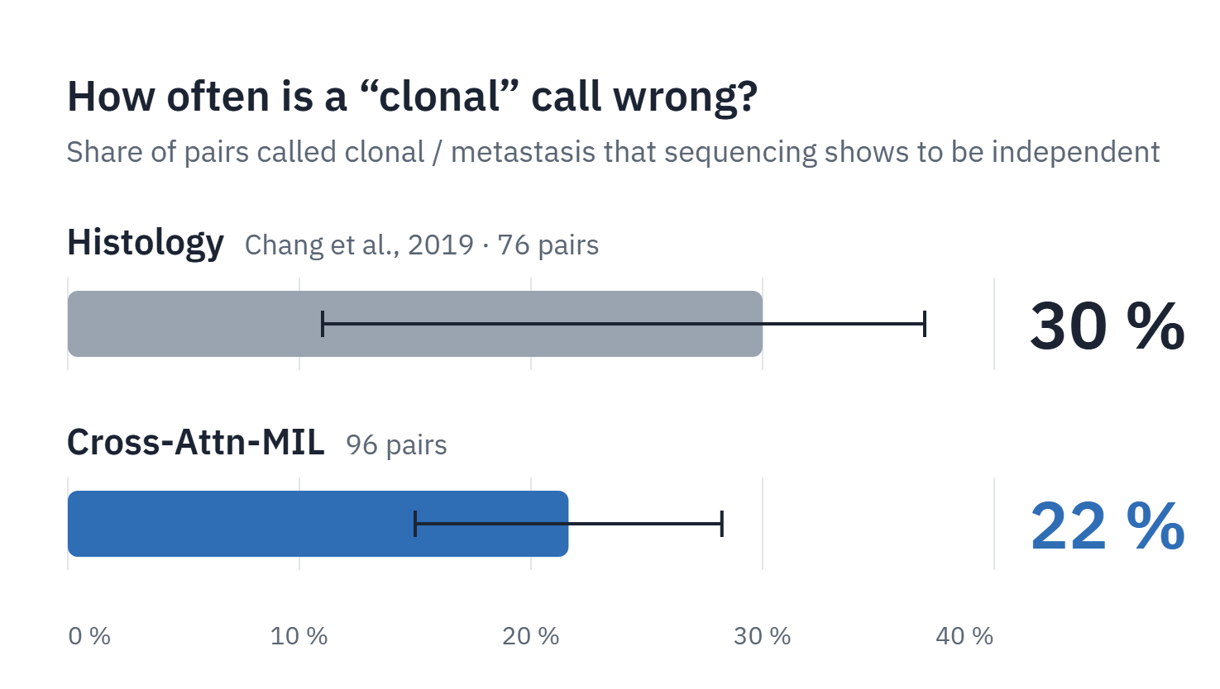
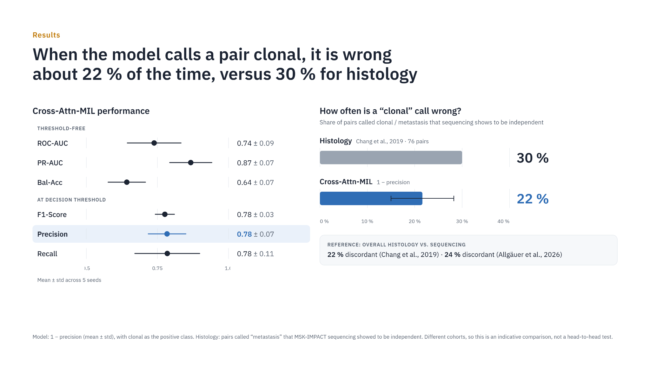
Results - Phase 1

Slide 24
Which mistake is worse?
You know precision and recall. Here is what each error costs a patient.
Model says “clonal” 10×
False “clonal”
Precision · our focus now
✓
✓
✓
✕
✓
Model says Clonal · sequencing shows Independent
→ Palliative instead of curative treatment
✓
✓
✓
✕
✓
8 / 10 correct
False “independent”
Recall · next step
Model says Independent · sequencing shows Metastasis
= 80 % precision
→ Local treatment only, while the disease has spread
Both errors harm patients. We start with the one that takes away a chance of cure.
Notes:
Again: precision means, every time the model says 'clonal', is it correct? Which metric matters depends on which error we care about. Error 1: we tell a patient they have metastatic cancer with a poor prognosis, while they actually have two separate, curable tumours. Error 2: we tell a patient they have separate tumours, while the disease has in fact spread. Both are bad, and we will extend to the second one, but for now we focus on the first, which is exactly what precision measures.

Slide 25
Results - Phase 1

Slide 26
Results - Phase 1
Good on average - but not useful in the clinic!

Slide 27
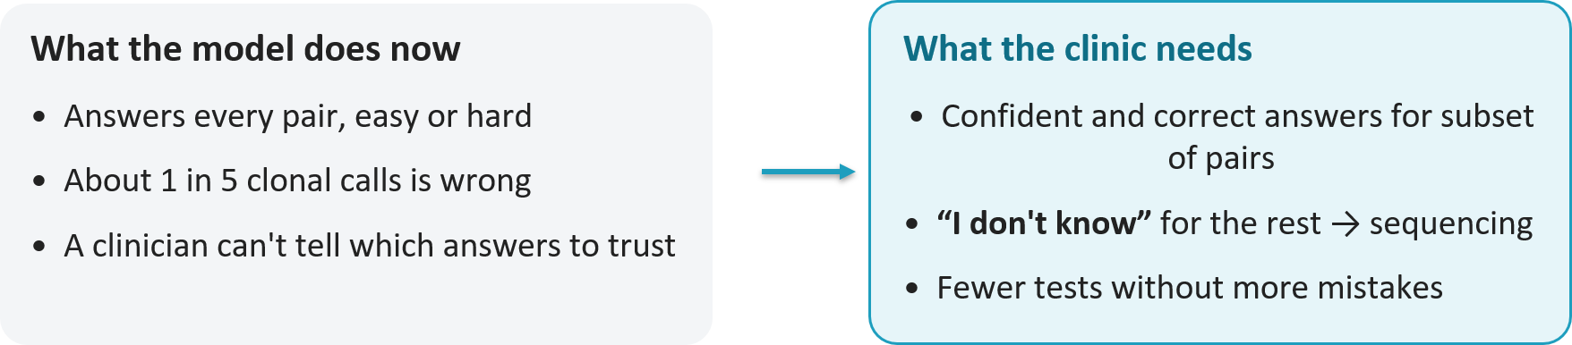
Good on average — but not useful in the clinic

Slide 28
Good on average — but not useful in the clinic

Slide 29
Good on average — but not useful in the clinic
Can we teach a model to know when not to answer?

Slide 30
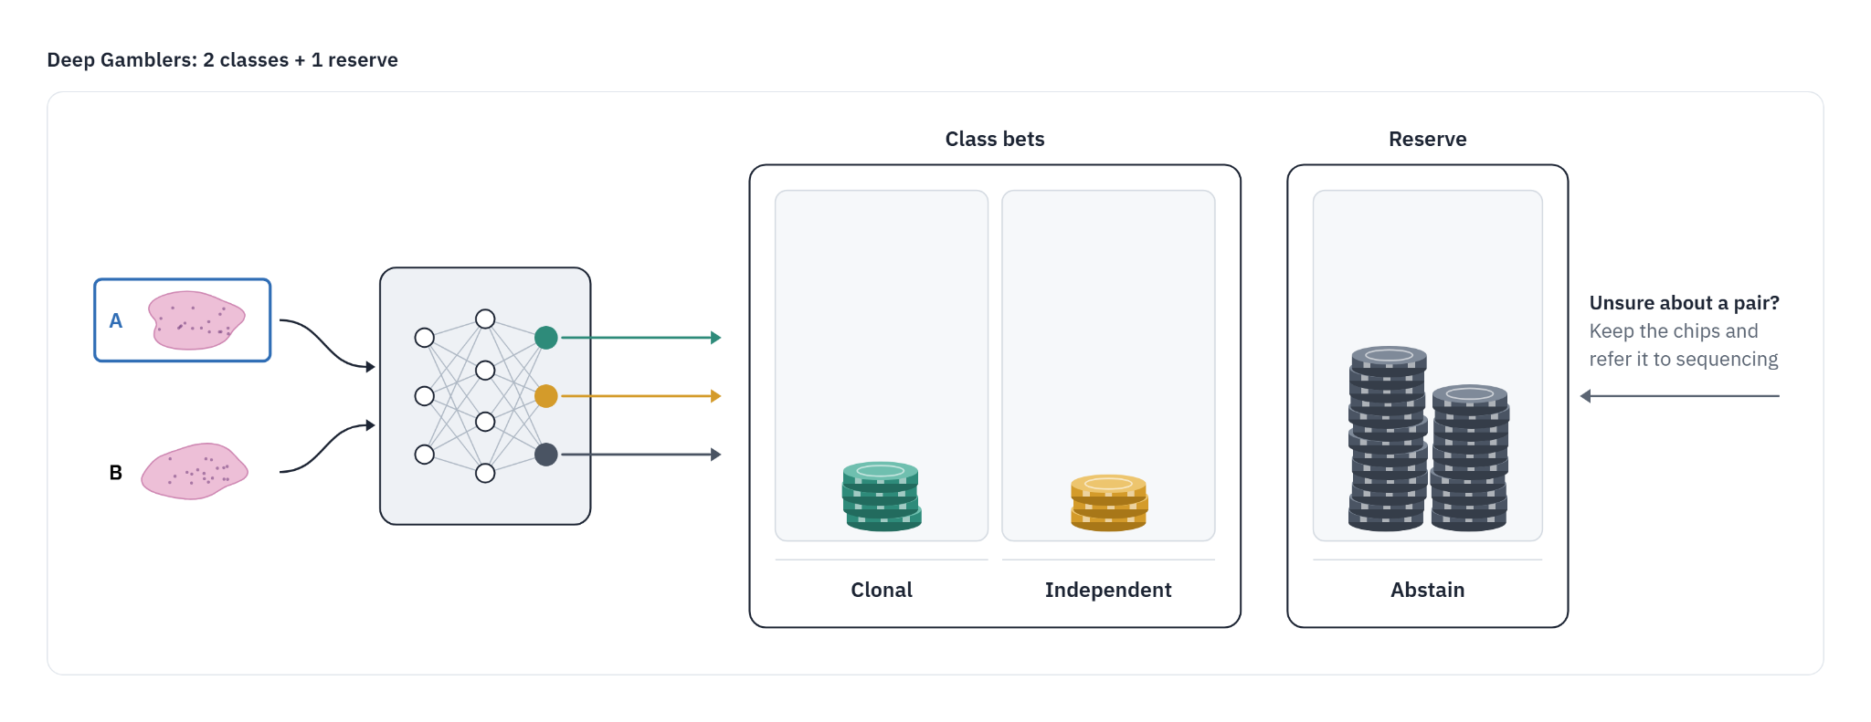
Deep Gamblers: Learning to Abstain (Liu et al., NeurIPS 2019)
• The model gets a third output: 'abstain/reserve'
• Training rewards a correct answer, punishes a wrong one, and pays a fixed, smaller reward for abstaining
• No change to the architecture; the reservation score is learned with everything else

Slide 31
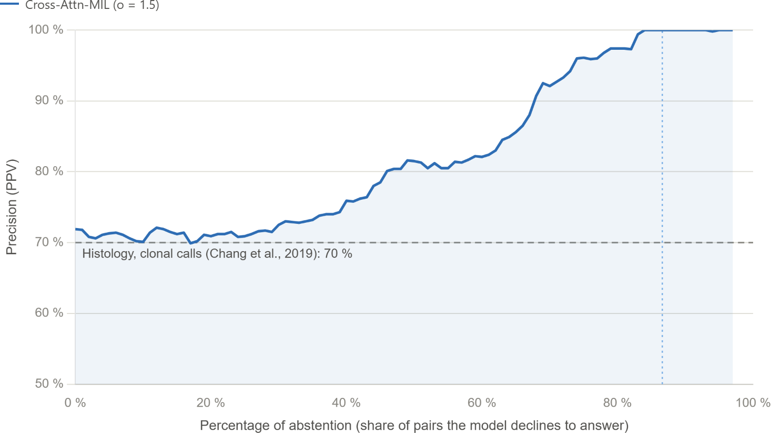
Deep Gamblers: Learning to Abstain (Liu et al., NeurIPS 2019)

Slide 32
Deep Gamblers: Learning to Abstain (Liu et al., NeurIPS 2019)
~98%
Model gave an answer for 20% of cases.
80% of cases were abstained.

Slide 33
High precision, but based on what?

Slide 34
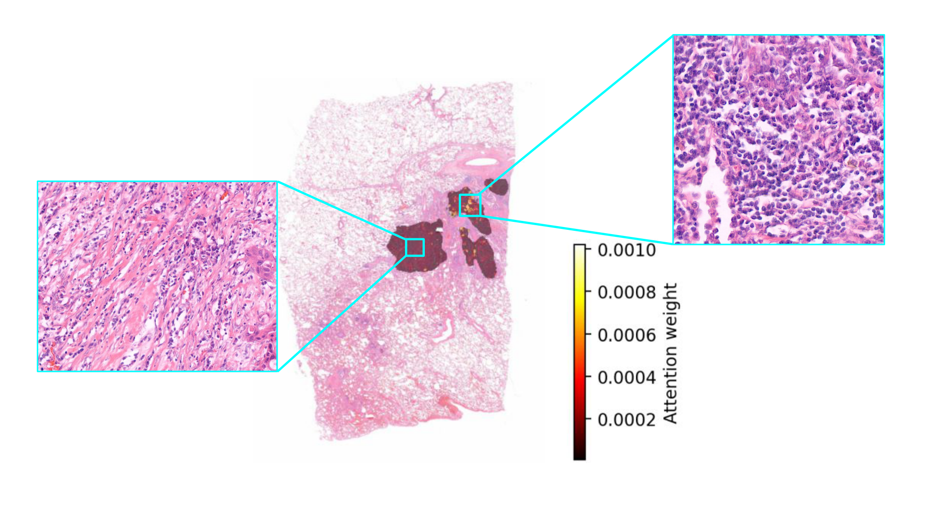
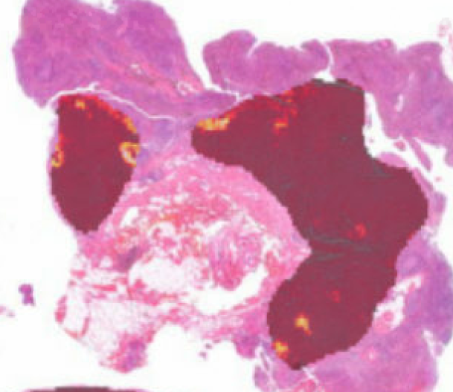
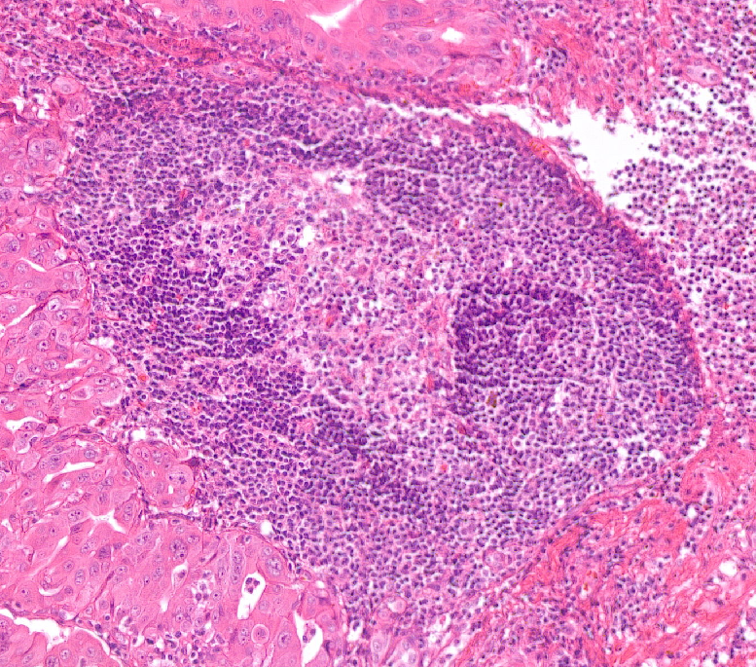
Where did the model look?
The model mainly focuses on tumor-associated stroma

Slide 35
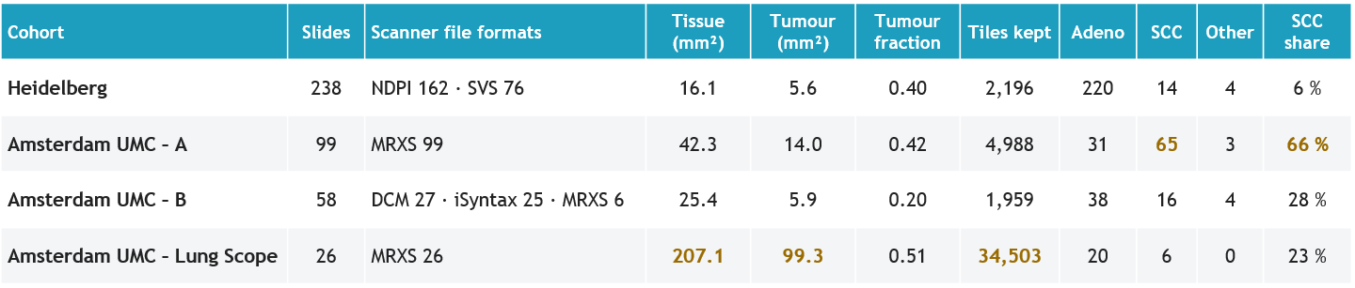
Shortcut learning or genuine signal?
Scanner differences?

Slide 36
Shortcut learning or genuine signal?
Scanner differences?
Tumour size?

Slide 37
Shortcut learning or genuine signal?
Scanner differences?
Tumour subtype?
Tumour size?

Slide 38
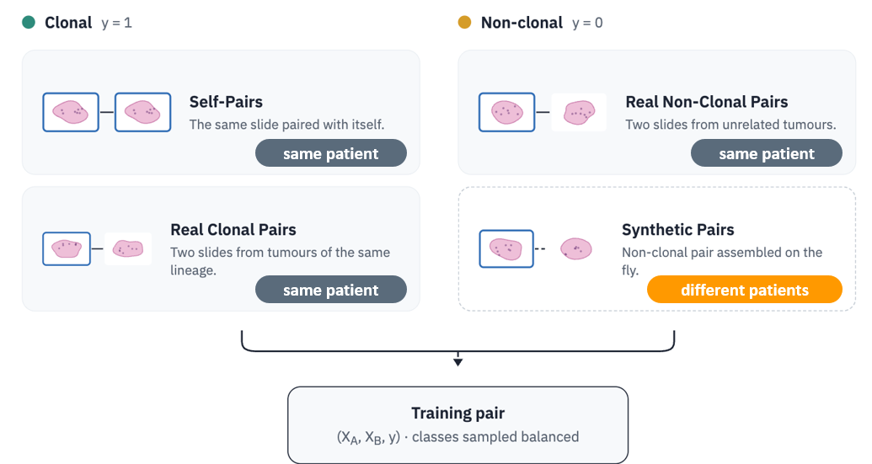
Shortcut learning or genuine signal?
Scanner differences?
Tumour subtype?
Tumour size?
Patient identity?

Slide 39
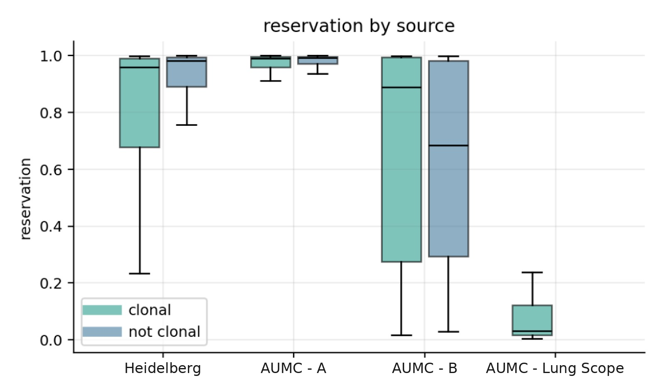
Shortcut learning or genuine signal?
Scanner differences?
Tumour subtype?
Tumour size?
never predict
always
abstain
class imbalance?
always
predict
never
abstain
Patient identity?

Slide 40
Shortcut learning or genuine signal?
AI is sneaky: it solves the easiest question that fits the labels
Tumour subtype?
Scanner differences?
Tumour size?
always
abstain
abstain
class imbalance?
never
abstain
Patient identity?

Slide 41
Shortcut learning or genuine signal?
AI is sneaky: it solves the easiest question that fits the labels
Tumour subtype?
Scanner differences?
Tumour size?
always
abstain
abstain
class imbalance?
..but it can also provide insights that humans might not consider.
never
abstain
Patient identity?

Slide 42

Future work
Scale up the data, then turn Deep Gamblers into a triage tool for the clinic
1 More slides from more centres
Heidelberg
Erasmus MC
MSKCC
240 WSIs
220 WSIs
200 WSIs

Slide 43

Future work
Scale up the data, then turn Deep Gamblers into a triage tool for the clinic
1 More slides from more centres
Heidelberg
Erasmus MC
MSKCC
240 WSIs
220 WSIs
200 WSIs
2 The potential: a triage tool that knows when not to answer
Confident → report clonality
~98 % precision on 20 % of pairs (Phase 1)
Every pair it answers saves
≈ €3,400
and >1 week of waiting
2 × ≈ €1,700 sequencing per tumour
Deep Gamblers
clonal / non-clonal
or abstain
Two lesions
H&E slides only
Abstain → sequence (NGS)
same as today, nothing lost

Slide 44



Conclusion
Clonality is hard
Histology and sequencing disagree in about 1 in 5 pairs; sequencing costs ≈ €1,700 per tumour and takes >1 week.
Morphology carries signal for a subset
There is evidence that part of the tumour pairs can be called from H&E alone.
Knowing when not to answer
To our knowledge the first image-based AI for clonality, built around abstention: Deep Gamblers turns an average model into a precise one on the cases it answers.
AI is powerful, and sneaky
It takes the easiest shortcut that fits the labels, but it can also point to cues pathologists might not consider.
Answer the cases you can, sequence the rest.

Slide 45
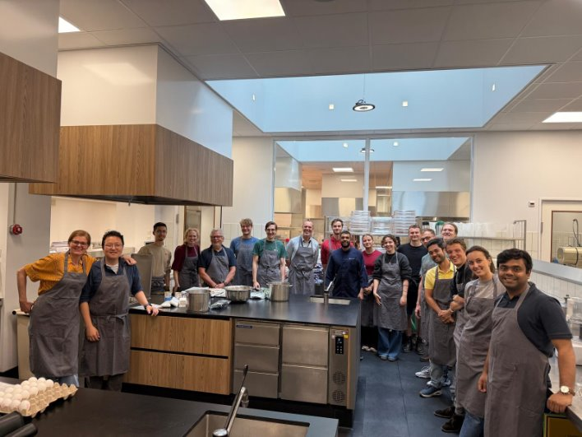
Acknowledgements
Dr. Richard Schoonhoven + Dr. Teodora Radonic
Dr. Hoel Kervadec
MMAI Group
TGAC Group
all the others that I forgot

Slide 46
Loss: ℓ = −log( p_y + p_abstain / o ), 1 < o < 2 small o → abstaining is cheap

